Slide 1
Max Flows: Generic
Preflow-Push Algorithm
CONTENTS:
Push / Relabel operation
Generic Preflow - Push Algorithm
READING ASSIGNMENTS:
Chap 7.6~7.7
Notes:
Obtain a network, and use the same network to illustrate the shortest path problem for communication networks, the max flow problem, the minimum cost flow problem, and the multicommodity flow problem. This will be a very efficient way of introducing the four problems. (Perhaps under 10 minutes of class time.)

Slide 2
Review of Augmenting Paths
At each iteration: maintain a flow x
Let G(x) be the residual network
At each iteration, find a path from s to t in G(x).
In the shortest augmenting path algorithm, we kept distance labels d( ), and we sent flow along the shortest path in G(x).

Slide 3
Preflows
At each intermediate stages we permit more flow arriving at nodes than leaving (except for s)
A preflow is a function x: A → R s.t. 0 ≤ x ≤ u and such that
e(i) = ∑_{j∈N} x_{ji} - ∑_{j∈N} x_{ij} ≥ 0,
for all i ∈ N – {s, t}.
i.e., e(i) = excess at i = net excess flow into node i.
The excess is required to be nonnegative.

Slide 4
A Feasible Preflow
2
0
2
2
5
3
2
1
3
2
s
4
t
3
0
2
3
1
The excess e(j) at each node j ≠ s, t is the flow in minus the flow out.
Note: total excess = flow out of s minus flow into t.

Slide 5
Active nodes
2
0
2
2
2
5
3
2
1
3
2
s
4
t
3
0
2
3
3
1
Nodes with positive excess are called active.
The preflow push algorithm will try to push flow from active nodes towards the sink, relying on d( ).

Slide 6
Review of Distance Labels
Distance labels d( ) are valid for G(x) if
i. d(t) = 0
ii. d(i) ≤ d(j) + 1 for each (i,j) ∈ G(x)
Defn. An arc (i,j) is admissible if r_{ij} > 0 and d(i) = d(j) + 1.
Lemma. Let d( ) be a valid distance label. Then d(i) is a lower bound on the distance from i to t in the residual network.

Slide 7
Push/Relabel, the fundamental subroutine
Suppose we have selected an active node i.
Procedure Push/Relabel(i)
begin
  if the network contains an admissible arc (i,j) then
  push δ : = min{ e(i), r_{ij} } units of flow from i to j;
  else replace d(i) by min{d(j) + 1 : (i,j) ∈ A(i) and r_{ij} > 0}
end;

Slide 8
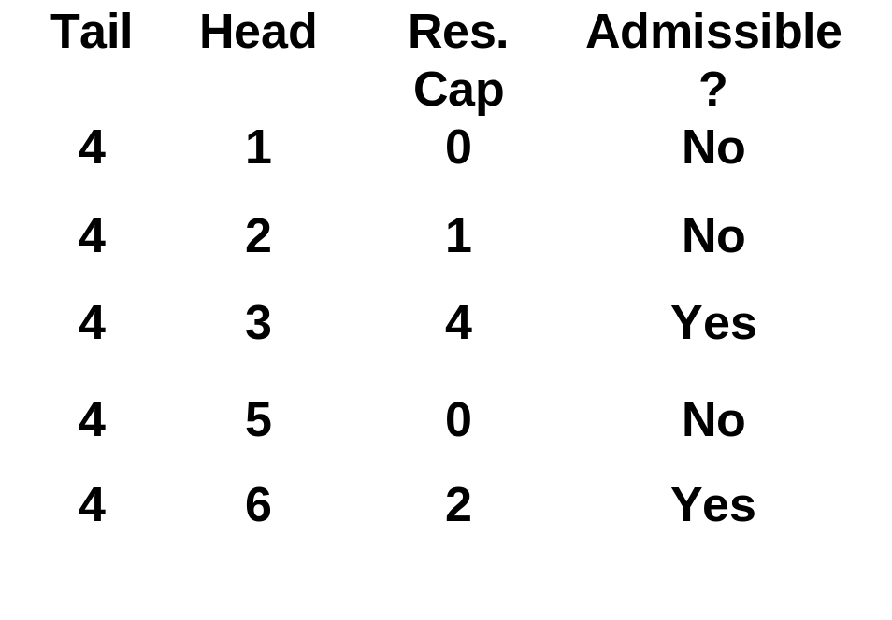
Pushing using current arcs
Suppose that node 4 is active, and has excess.
1
3
Scan arcs in A(4) one at a time using “Current Arc” till an admissible arc is found.
1
2
e(4) = 2
3
4
3
2
Push on (4,3)
6
2
5
2

Slide 9
Pushing on (4,3)
Push on (4,3)
2
1
3
Send min (e(4), r₄₃) = 2
units of flow.
1
2
e(4) = 2
e(4) = 0
e(3) = 1
e(3) = 3
Update the residual capacities and excesses.
3
4
3
2
For the next push from node 4, start with arc (4,3).
6
2
5
2

Slide 10
Goldberg-Tarjan Preflow Push Algorithm
Procedure Preprocess
begin
  x :=0;
  compute the exact distance labels d(i) for each node;
  x_{sj} := u_{sj} for each arc (s,j) ∈ A(s); d(s) := n;
end
Algorithm PREFLOW-PUSH
begin
  preprocess;
  while there is an active node i do
  begin
    select an active node i;
    push/relabel(i);
  end
end
Preflow Push Algorithm

Slide 11
Preview of Results on Preflow Push
The preflow push algorithm is superb both in theory and in practice.
To prove:
1. d(j) < 2n throughout the algorithm
2. The algorithm terminates with a maximum flow
3. The number of steps excluding non-saturating pushes is O(nm)
4. The number of non-saturating pushes is O(n²m).
Further improvements are possible.

Slide 12
A lemma needed for the time bounds
Lemma 7.11. At each stage of the algorithm, there is a path in G(x) from each node i with e(i) > 0 to node s.
-2
0
Here is the same preflow as before
2
2
2
5
3
2
1
3
2
9
s
4
t
-6
As a flow, the “excesses” are negative supplies.
3
0
2
3
3
-1
Proof. Apply flow decomposition to the flow x.

Slide 13
2 units in s-2-5-t; 2 units in s-4-t 2 units in s-3-t
1 unit in s-2 1 unit in s-4-2
1 unit in s-3
For each node j with “excess” there is an s-j path P in the flow decomposition.
-2
0
2
2
2
5
3
2
1
3
2
9
s
4
t
-6
3
0
The reversal of P is in G(x).
2
3
3
-1
This completes the proof.

Slide 14
Bounding d(j)
Lemma 7.12. For each node j with excess,
d(j) ≤ 2n - 1.
Proof. Let f(j) be the length of the shortest path in G(x) from node j to node s. then
d(j) ≤ d(s) + f(j) ≤ n + (n-1) = 2n - 1.
Lemma 7.13. Each node is relabeled fewer than 2n times, and so the total number of relabels is fewer than 2n².

Slide 15
Theorem. The preflow push algorithm is finite and terminates with the maximum s-t flow.
Proof. The algorithm is finite because the distance labels can increase at most 2n times each.
The algorithm ends with a flow (as opposed to preflow) because if there were any active node, the algorithm would not end.
At the end, d(s) = n. Since d(s) is a lower bound on the shortest s-t path in G(x), there is no s-t path in G(x), and the flow is maximum.

Slide 16
Bounding the time for relabels
Time to relabel:
  To relabel node j, one needs to scan each arc of A(j)
  So, each arc gets scanned at most 2n times
  Total relabel time is O(nm)

Slide 17
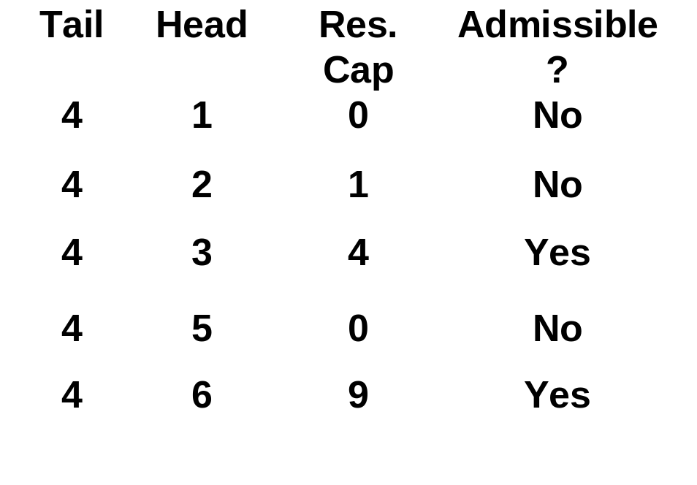
Bounding the remaining steps
Push Flow from node 4.
0
1
3
Send min (e(4), r₄₃) = 4 units of flow.
1
2
e(4) = 7
e(4) = 3
e(3) = 1
e(3) = 5
Update the residual capacities and excesses.
3
4
3
2
In a saturating push in (i,j) the flow is r_{ij}.
6
2
5
2

Slide 18
Computation time
Moving “current arc” for i. |A(i)| steps between relabels. This run time is no more than the time for a relabel of node i.
Saturating pushes for i. At most |A(i)| between relabels of i. Once an arc is saturated, the current arc will increase by 1.
But the bottleneck are the non-saturating pushes.

Slide 19
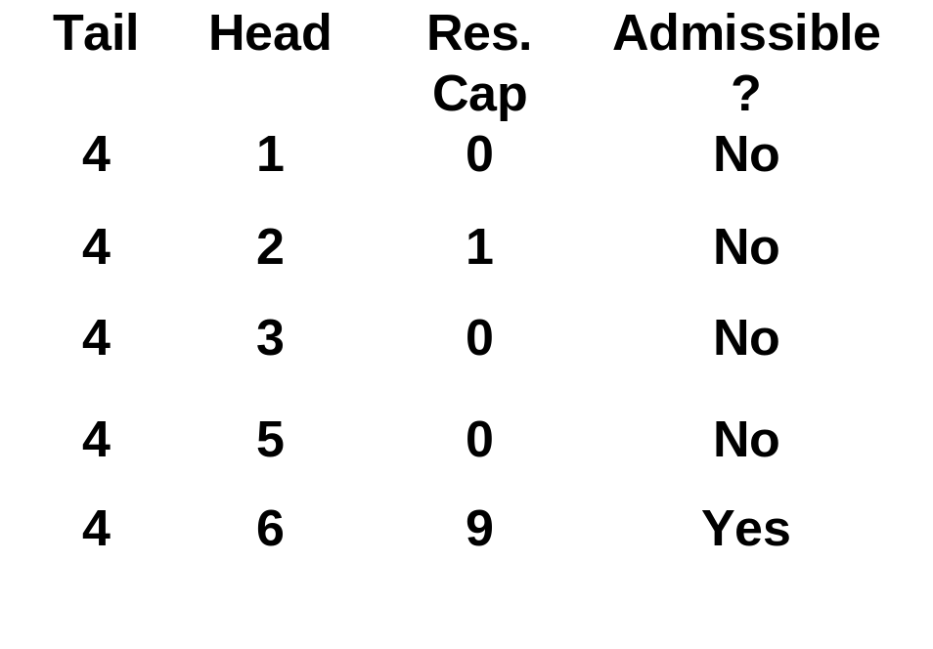
Bounding the remaining steps
Push Flow from node 4.
6
1
3
Send min (e(4), r₄₆) = 3 units of flow.
1
2
e(4) = 7
e(4) = 3
e(4) = 0
Update the residual capacities and excesses.
3
4
3
2
Note: CurrentArc will stay on node (4,6)
6
2
5
2
e(6) = 3
e(6) = 0

Slide 20
Review of run time analysis
Time to select active nodes is O(1) per push since we can maintain a set of active nodes.
We bounded relabels and relabel time
We bounded all time in pushing, except for non-saturating pushes
  Time to advance “currentArc” is bounded by the time to relabel
  Time for saturating pushes is bounded by the time to advance “currentArc”
Non-saturating pushes really are the bottleneck.
  We will use a different analysis technique to bound them

Slide 21
Potential Functions -- accounting version
Example 1. Consider a joint bank account held by persons A and B.
The account starts with an initial deposit of $1,000.
  A only makes withdrawals, and each is for $10 or more.
  B makes deposits and withdrawals. Each deposit is for at most $100. B has made at most 20 visits to the bank, and at most one deposit at each visit.
  The account never goes below $100.
What is the maximum number of times that A has made withdrawals?
(1000+100*20-100)/10
Notes:
(1000+100*20-100)/10

Slide 22
Example 2
Consider a joint bank account held by persons A, B, and C
The account starts with an initial deposit of at most n².
  A only makes withdrawals, each for 1 or more.
  B makes fewer than 2n² deposits. Each deposit is for at most 1.
  C makes fewer than nm withdrawals and deposits. Each deposit is for at most 2n.
  The account never goes below 0.
A: non-saturating push; B: relabel; C: saturating push
What is the maximum number of withdrawals for A?
Initial deposit: initial sum of d(); A: non-saturating push
B: relabel; C: saturating push
(n²+2n²+2n*nm)/1

Slide 23
A Potential Function for Preflow-Push
Let F = ∑_{j active} d(j).
We call F a potential function.
It plays the role of the account level (total dollars) in the shared bank account in the previous example.

Slide 24
Initial value of F = ∑_{j active} d(j).
3
s
4
2
2
2
5
1
5
3
1
1
1
4
2
4
3
s
2
6
4
1
1
t
0
2
2
3
2
2
s
s
2
1
1
3
3
4
4
5
3
1
1
0
t
3
Add up distance labels of active node. 1 + 1 + 2
In general, F is bounded initially by n².

Slide 25
Effect of relabels on F = ∑_{j active} d(j)
1
s
4
2
2
2
2
2
2
4
5
1
2
2
3
3
5
2
3
1
1
4
2
1
2
4
3
5
s
2
6
4
1
1
t
0
2
2
3
2
s
s
3
2
3
4
4
1
1
4
5
5
2
2
2
0
t
1
1
Consider the relabel of node 2.
F increases from 2 to 4. Each unit increase in d(2) increases F by 1.

Slide 26
More on relabels
Recall: a “deposit” is an increase in F. The value of the deposit is the increase in F.
d(2) < 2n. So, the total “deposits” over all iterations from relabeling node 2 is at most 2n.
The total “deposits” from relabeling all nodes is at most 2n².

Slide 27
Effect on F of non-saturating pushes
1
3
2
1
0
s
4
1
2
2
2
2
2
2
5
1
2
2
3
3
3
5
3
2
3
1
1
4
1
2
4
3
5
5
s
2
6
4
1
1
t
0
2
2
3
2
s
s
3
2
3
4
1
1
4
5
5
2
2
2
0
t
1
1
Consider the non-saturating push from node 5 to node 2.
5 becomes inactive, and node 2 becomes active.
F decreases by d(5)-d(2) = 1.

Slide 28
More on non-saturating pushes
s
Recall: a withdrawal is a decrease in F.
5
If there is a non-saturating push in (5, 2), then node 5 is active before the push and inactive afterwards. Node 2 is active after the push.
4
3
5
5
2
2
2
s
s
3
Either F decreases by d(5) – d(2) = 1 or else F decreases by d(5).
1
4
5
5
0
t
Conclusion: every non-saturating push leads to a withdrawal of at least 1.
Recall: The entire point of this analysis is to bound the number of non-saturating pushes.

Slide 29
Effect on F of saturating pushes
3
2
1
s
4
1
2
2
2
2
5
2
2
5
3
3
1
1
4
1
2
2
3
s
2
6
4
1
1
1
t
0
2
3
0
2
s
1
s
3
5
1
1
4
4
2
2
2
0
t
1
1
Consider a saturating push from node 5 to node 4.
In this case, node 4 becomes active.
F increases by d(4) = 1.

Slide 30
More on Saturating Pushes
Recall: a “deposit” is an increase in F. The value of the deposit is the increase in F.
A saturating push in (5, 4) can lead to a deposit.
The max deposit occurs when node 4 becomes active and node 5 stays active. The increase would be d(4)
The max deposit from a push in arc (i,j) is d(j) < 2n.
There are at most nm saturating pushes.
Conclusion: the total deposits from saturating pushes is at most 2n²m.

Slide 31
Putting it all together
F = ∑_{j active} d(j). Initially, F < n². At end, F = 0.
Deposit: an increase in F
Withdrawal: a decrease in F.
Each non-saturating push is a withdrawal of at least 1.
The total deposits from relabels is at most 2n².
The total deposits from saturating pushes is at most 2n²m.
Conclusion: the number of non-saturating pushes is at most n² + 2n² + 2n²m = O(n²m).

Slide 32
Summary
Preflow-Push Algorithm
Relies on pushes in a single arc and on relabels
Number of relabels is O(n²)
Number of pushes is O(n²m)
Bottleneck operation: non-saturating pushes.
Use of potential functions to prove time bounds.

